Slide 1
Brooklyn Real Estate: A Data Analysis Jay Morrison
April 2015

Slide 2
Project Overview & Motivation
Initial Question: Can a model predict the price of Brooklyn-based real estate?
Refined Question: Can the price of a 1, 2 or 3 family home in Brooklyn in 2003 & 2004 be predicted?
Motivation: Improve the real estate appraisal process
Significant variation between listing price and appraisal price:
Assessment commonly based on intuition, hyper-local comparable sales
Fear of appraising at too high of price, causing price distortions
Regulation encourages banks to use in-house or affiliated appraisers, creating a conflict of interest

Slide 3
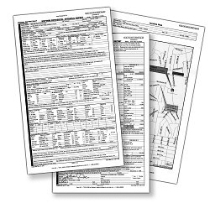

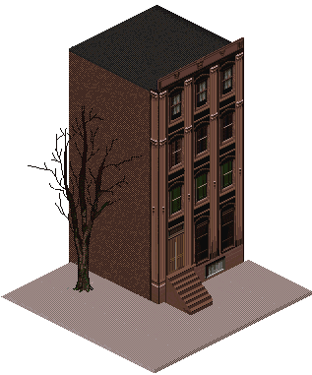
Hypothesis
Real estate appraisals based on a broader data set (e.g. geographical, historical sales, etc.) would improve market transparency for buyers and sellers
Common Appraisal Process
Enhanced Appraisal Process
Cobble Hill
Model
Customized Appraisal
Cobble Hill Appraisal
Cobble Hill Appraisal
Cobble Hill Apartment
Cobble Hill Apartment

Slide 4
Data Summary
Selected Data Fields
Data Set Overview
Address
Latitude / Longitude
Neighborhood
Median Neighborhood Income
Building Type
Square Feet
Year Built
Sale Price
Sale Date
100,000 transactions (‘03-’09)
16,000 transactions (‘03-’04)
59 neighborhoods
Income range: $27k – $111k
41 Types (Res. + Comm.)
500sf – 1000000sf
Built 1800 – 2009
$250k - $200M
2003 – 2009
Data Sources
NYC.gov
Data Science Tool Kit.org

Slide 5
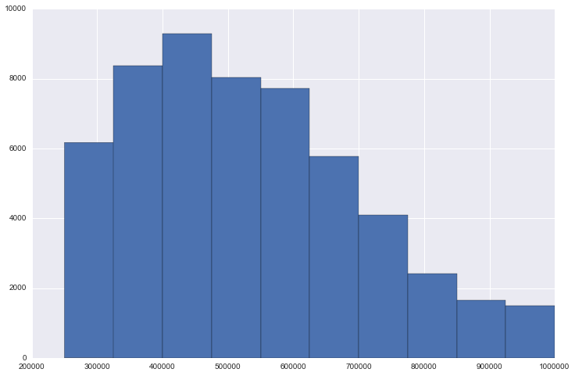
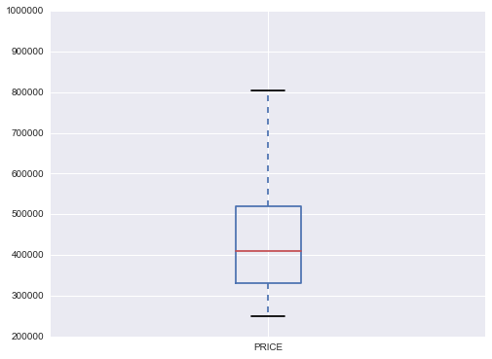
Exploratory Approach: Making Sense of Brooklyn Real Estate
Histograms
Box Plots
$445,000
23%
6%
Residential Brooklyn real estate* is characterized by a few high priced outliers
*One, Two and Three Family Homes

Slide 6
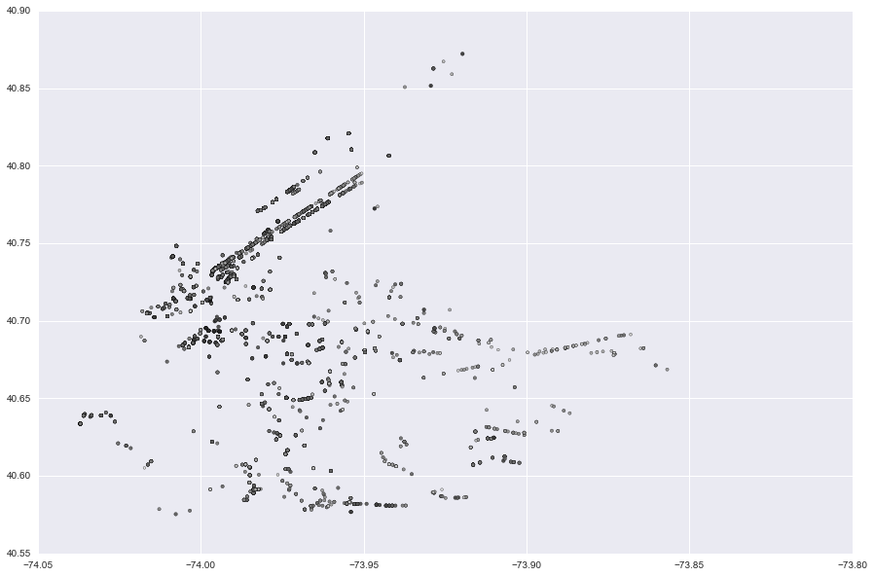
Exploratory Approach: Making Sense of Brooklyn Real Estate
Visualizations
Bubble size = price
Latitude
Longitude

Slide 7
Predictive Analysis Approach
Feature Selection: Identify features were p value < .05
# of Commercial Units
# of Residential Units
Latitude / Longitude
Square Footage
Year Built
Tested Features
Identified Features
# of Residential Units
Latitude
Square Footage

Slide 8
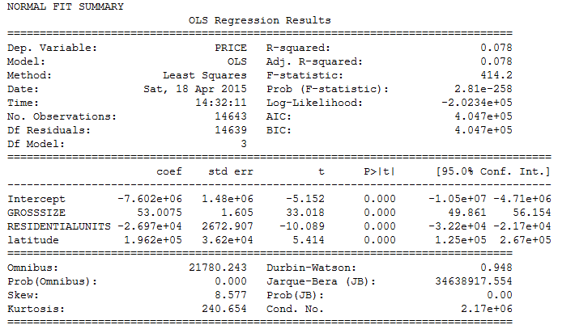
Predictive Analysis Approach
Linear regression with identified features – Price as dependent variable

Slide 9
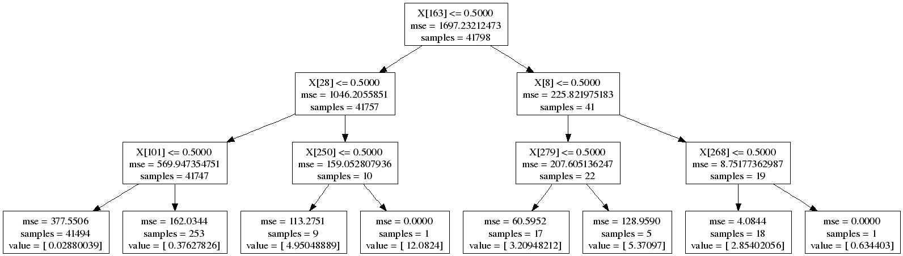
Predictive Analysis Approach
Generate Decision Tree
Feature Selection: # of Residential Units, Latitude, Square Footage
Split into Test / Train
Calculate Mean Square Errors (large!!! – yikes!)
Run cross-validation to find optimal depth
Convert .DOT file into .PNG and use GraphViz to visualize

Slide 10
Lessons Learned
Linear regression offered little explanation of price (dependent variable)
Decision trees provided a more structured approach to segmenting the data
However, MSE was large
Segmenting data into neighborhoods based on median income did not improve decision tree

Slide 11
Next Steps
Conduct time series analysis of price fluctuations using real estate transactions from 2003 – 2014
Visualize price / square footage changes
Broaden analysis by including additional demographic information
Income
Families
Commercial development (e.g. how does introducing a Starbucks or Whole Foods into the neighborhood impact price?)

